Slide 1
COVID Unemployment Labor Force
Bernalillo County, NM
Jack Chen

Slide 2
Motivation
Inverse relationship: economy and infection rate
National Labor force participation rate: 63.4% -> 61.6%
County’s Unemployment rate: 4.5% -> 13% -> 5.4%
Notes:
https://www.bls.gov/charts/employment-situation/civilian-labor-force-participation-rate.htm

Slide 3
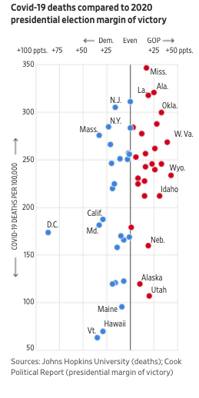
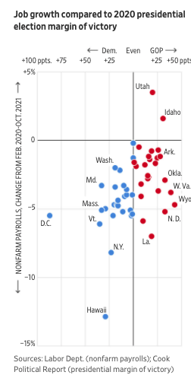
Motivation
Inverse relationship: economy and infection rate
National Labor force participation rate: 63.4% -> 61.6%
County’s Unemployment rate: 4.5% -> 13% -> 5.4%
Notes:
https://www.bls.gov/charts/employment-situation/civilian-labor-force-participation-rate.htm

Slide 4
Problem Statement
Does COVID infection rate cause unemployment or dropping out of the labor force?

Slide 5
Research Method
Granger causality test: a statistical hypothesis test for determining whether one time series is useful for forecasting another
X Granger-cause Y = Lagged values of X provide statistically significant information about future values of Y
Notes:
https://www.sciencedirect.com/topics/social-sciences/granger-causality-test

Slide 6
Data
Kaggle repository of John Hopkins University COVID-19 data
US Bureau of Labor Statistics (Unemployment, Labor Force)
Notes:
https://www.kaggle.com/antgoldbloom/covid19-data-from-john-hopkins-university?select=RAW_us_confirmed_cases.csv

Slide 7
Results – p values
 | Cause: Labor Force | Cause: Unemployment | Cause: Infection Rate
Response: Labor Force |  |  | 0.0272
Response: Unemployment |  |  | 0.7012
Response: Infection Rate |  | 0.0059

Slide 8
Results – p values
 | Cause: Labor Force | Cause: Unemployment | Cause: Infection Rate
Response: Labor Force |  |  | 0.0272
Response: Unemployment |  |  | 0.7012
Response: Infection Rate |  | 0.0059

Slide 10
Potential Reasons
Stay-at-home order (03/19/2020)
Testing capacity
“Back to Normal”

Slide 11
Conclusion
Counterintuitive causation results
Caution: Not enough data – monthly employment snapshots

